Slide 1
Radio Cabs
Group 2 – C1012L
Minh-Duong Hoang
Tran-Kien Nguyen
Huu-Chuan Luu
Viet-Cuong Le

Slide 2
Introduction
Provides information about Radio Taxi companies and their services
Find all information you need about Radio Taxi Rental Services with their respective companies

Slide 3
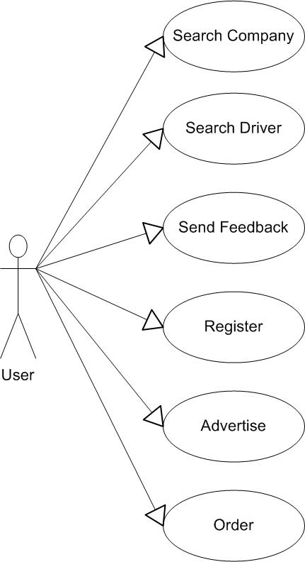
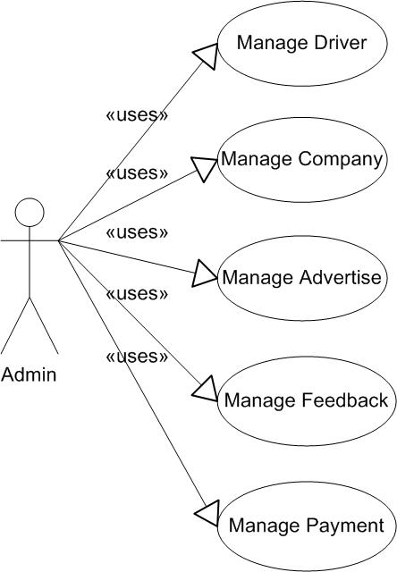
Requirement

Slide 4
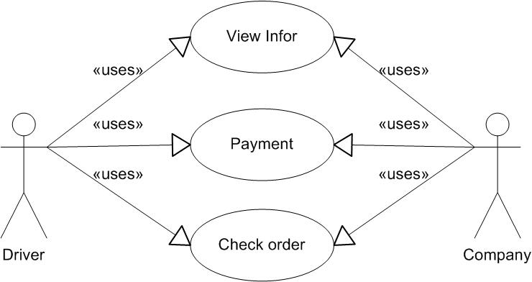
Requirement

Slide 5
Functional Requirement
Home page:
Introduction
Menu: Listing, Drivers, Services, Advertise, Feedback
Listing page:
Search company
Register company

Slide 6
Functional Requirement
Driver page
Search driver
Register driver
Advertise page
Order advertise
Feedback page
Send feedback

Slide 7
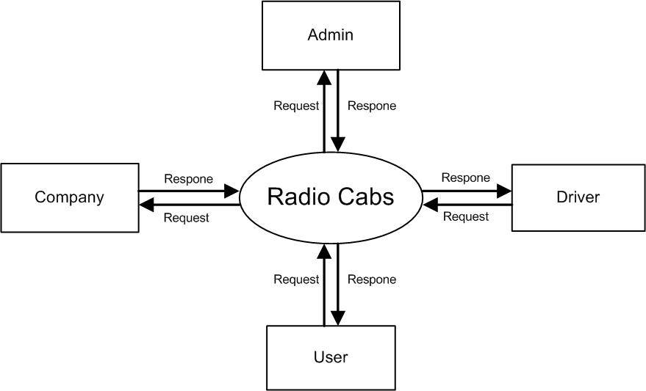
DFD Level 0

Slide 8
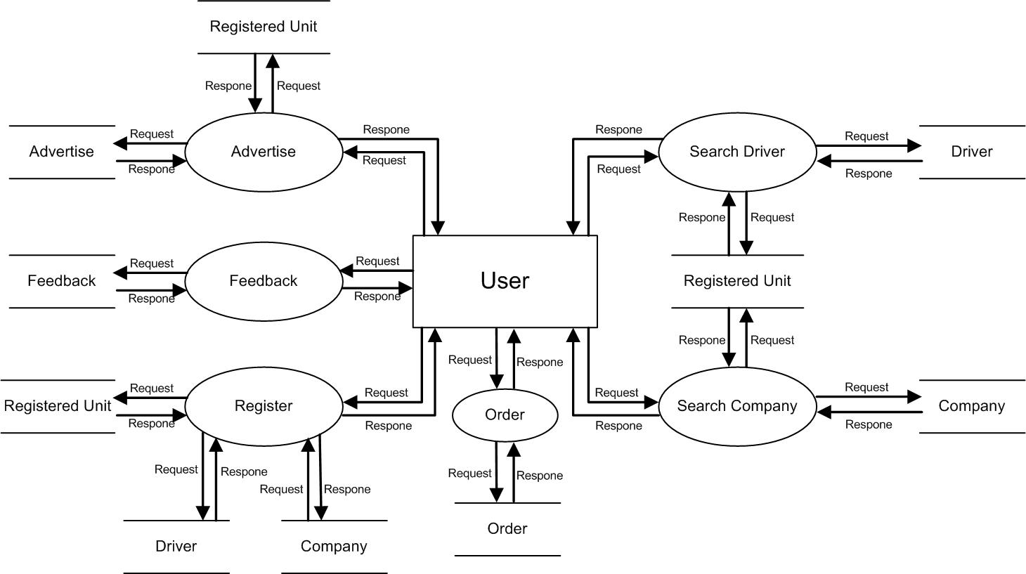
DFD Level 1

Slide 9
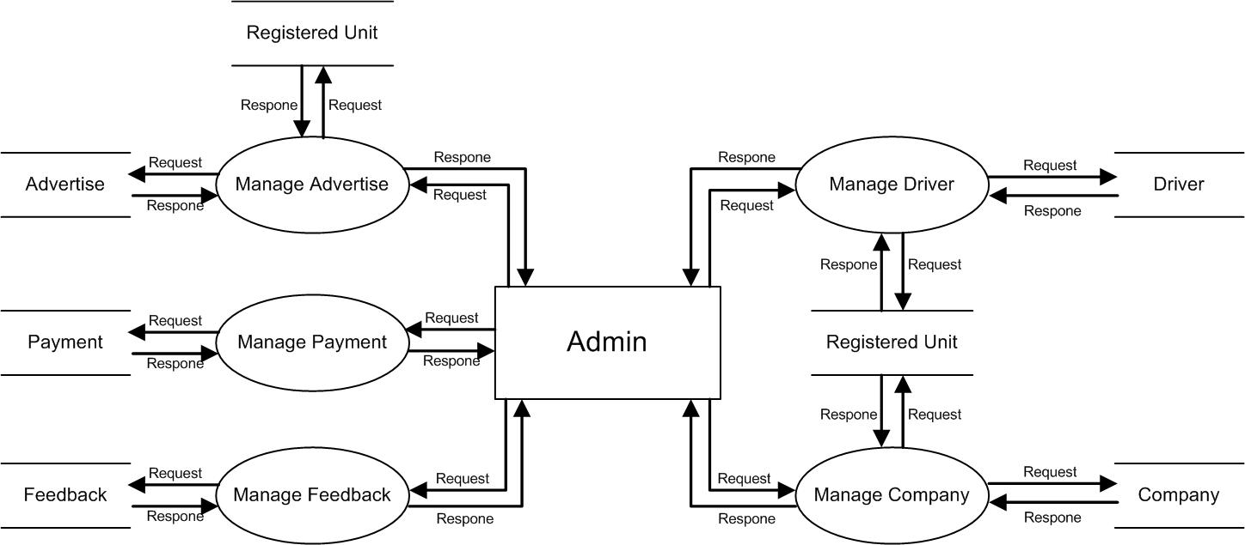
DFD Level 1

Slide 10
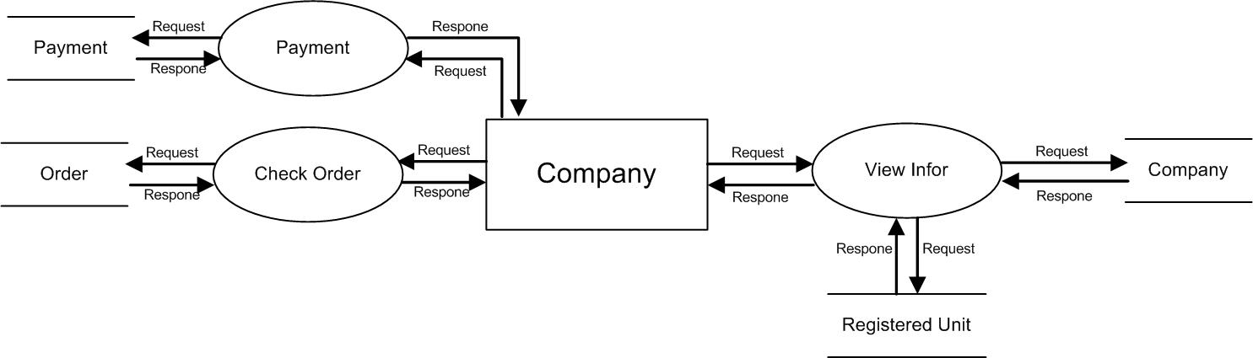
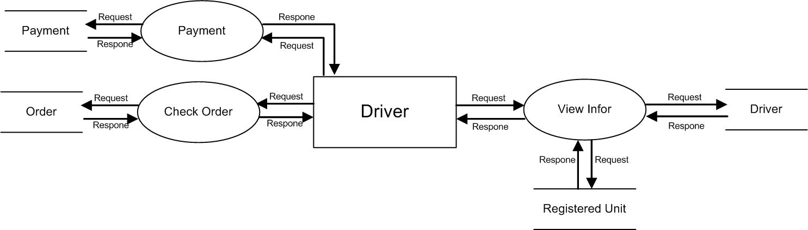
DFD Level 1

Slide 11
ERD

Slide 12
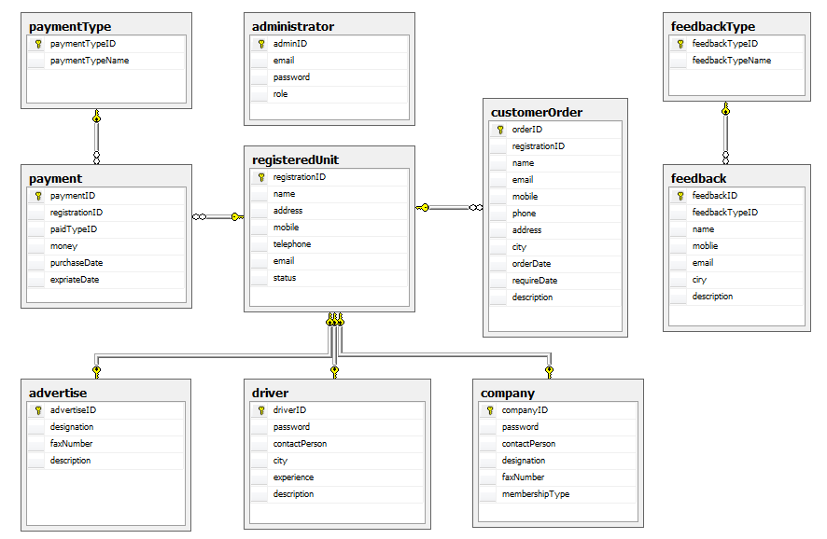
Database Diagram

